Slide 1


Setting SSH Keys for GitHub

Slide 2

Agenda
What are SSH Keys
Reasons to use it
Scalability
Keys: Public and Private
Setting up process
Setting an SSH key for Github
Resources

Slide 3
SSH Keys - What are they?
The SSH keys are a pair of 2 files. These files contain algorithmic generated long, random strings characters used instead of a password. You need both of them to establish a connection.
This pair of keys will allow (or deny) access to connect to a server
One of them is Public, and the other one private.
That’s the reason they are called ’keys’: if the SSH in the server matches the one on the client side, the connection is allowed.

Slide 4
SSH Keys - Reasons to be
SSH Keys are a Public key encryption algorithms work with two separate keys. These two keys form a pair that is specific to each user.
Passwords could be problematic: they need to be remembered, they are not as strong cryptographically, and anyone with the password could have access. In SSH keys, having only one of the files won’t help.
It can be used to authenticate without using passwords.
Harder to brute force.

Slide 5
SSH Keys - Scalability
SSH creates a public key and a private key pair. The public key could be used by anyone.
Pretty much every server could be set up to use SSH Keys. It is more secure and faster.
One function for encrypting the data (public key) but decrypting is kept secret (private key).
On the repositories world, SSH keys are very useful when there is the need to handle several accounts. Instead of logging in and out, you can set several SSH keys (one for each account) and just switch users.

Slide 6
SSH Keys - Public Key
A public key is copied to the SSH server(s). Anyone with a copy of the public key can encrypt data which can then only be read by the person who holds the corresponding private key. Once an SSH server receives a public key from a user and considers the key trustworthy, the server marks the key as authorized in its authorized_keys file. Such keys are called authorized keys.

Slide 7
SSH Keys - Private Key
A private key that remains (only) with the user. The possession of this key is proof of the user's identity. Only a user in possession of a private key that corresponds to the public key at the server will be able to authenticate successfully. The private keys need to be stored and handled carefully, and no copies of the private key should be distributed. The private keys used for user authentication are called identity keys.
It is extremely important that the privacy of the private key is guarded carefully. For most user-driven use cases this is accomplished by encrypting the private key with a passphrase.

Slide 8
SSH Keys - Set up
The following simple steps are required to set up public key authentication (for SSH):
Key pair is created (typically by the user). This is typically done with ssh-keygen.
Private key stays with the user (and only there), while the public key is sent to the server.
Server stores the public key (and "marks" it as authorized).
Server will now allow access to anyone who can prove they have the corresponding private key.

Slide 9
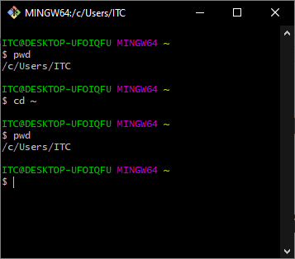
SSH Keys - Setting an SSH Key for GitHub
Open a terminal window.
Let’s check which one is our default Home directory. We can see that by doing:
cd ~ && pwd

Slide 10
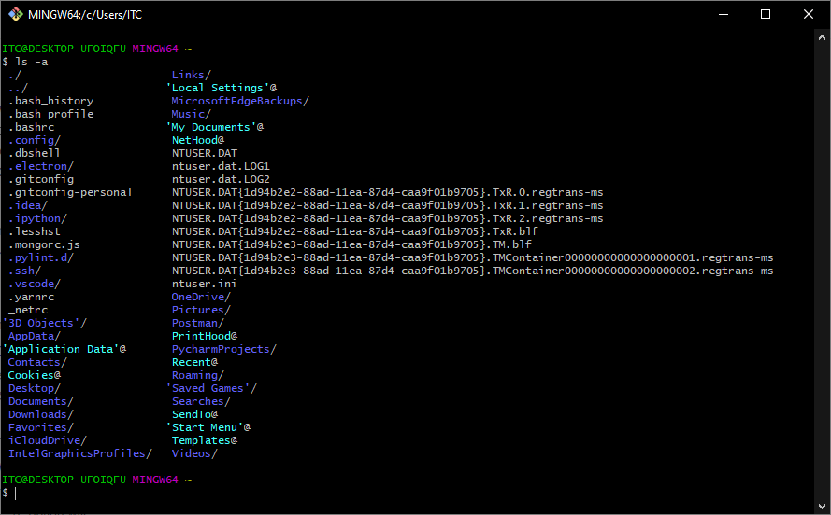
SSH Keys - Setting an SSH Key for GitHub
Lets see all the files in the home directory now:
ls -a
The -a option is for hidden files.

Slide 11
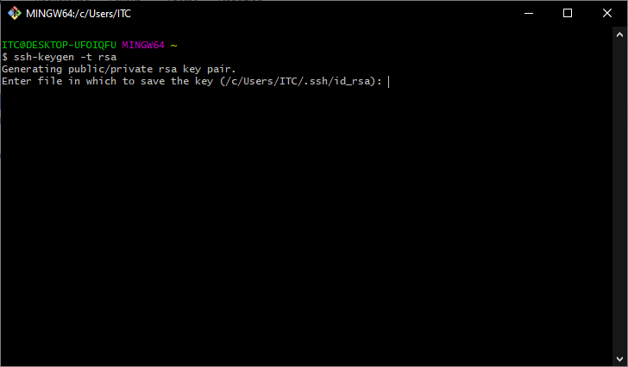
SSH Keys - Setting an SSH Key for GitHub
Create a new pair:
ssh-keygen -t rsa
-t rsa: option for the type.
It is going to be created in your home path under that name:
~/.ssh/id_rsa

Slide 12
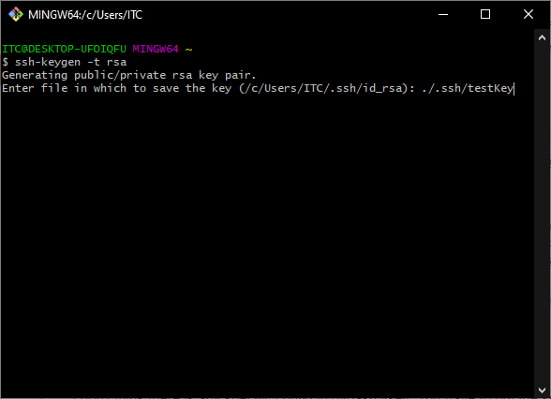
SSH Keys - Setting an SSH Key for GitHub
If you want to give it a new name different than the default you need to type the whole path:
./.ssh/testKey

Slide 13
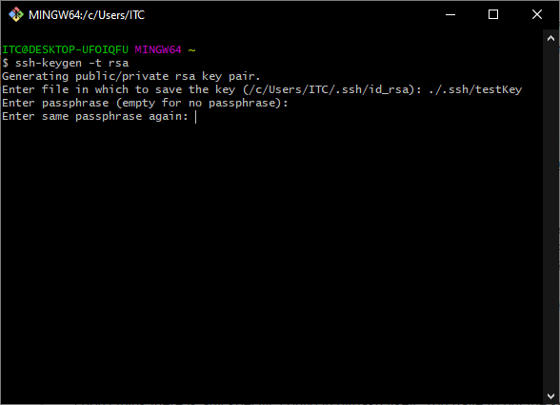
SSH Keys - Setting an SSH Key for GitHub
Enter a passphrase (optional). Highly recommended.
Repeat it when prompted.

Slide 14
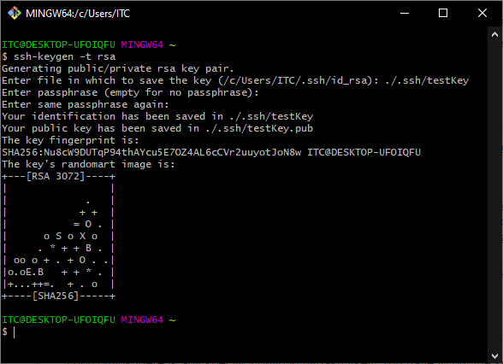
SSH Keys - Setting an SSH Key for GitHub
Success! We have created the SSH key pair.

Slide 15
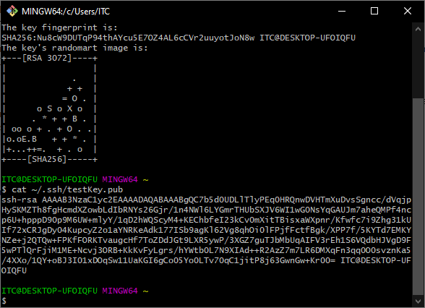
SSH Keys - Setting an SSH Key for GitHub
Let’s copy its content to put it into Github:
cat ~/.ssh/testKey.pub
Copy the value.

Slide 16
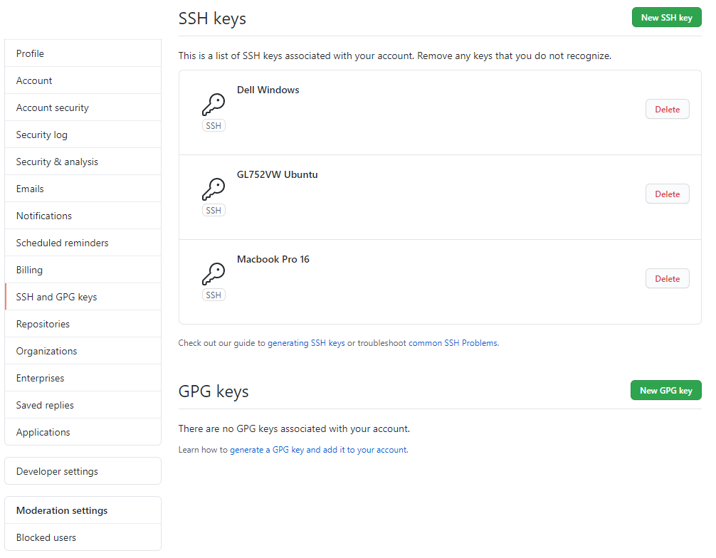
SSH Keys - Setting an SSH Key for GitHub
Click on New SSH Key

Slide 17
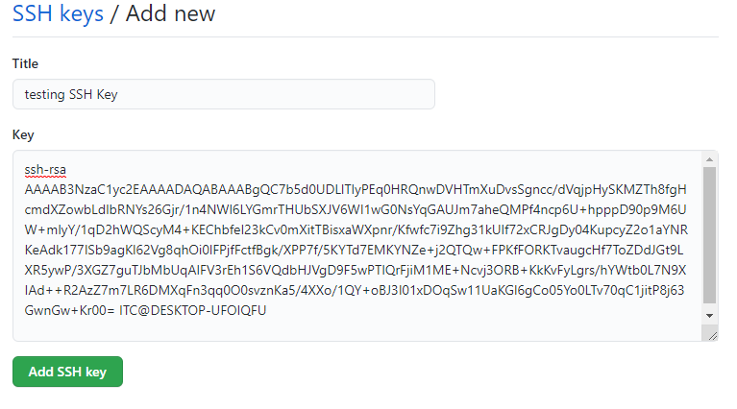
SSH Keys - Setting an SSH Key for GitHub
Paste the SSH Public Key, and add the SSH key.
Then go back to your terminal

Slide 18
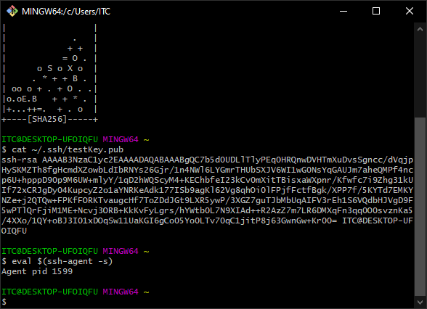
SSH Keys - Setting an SSH Key for GitHub
Run the eval agent:
eval $(ssh-agent -s)
You should get a message with an Agent pid + a number

Slide 19
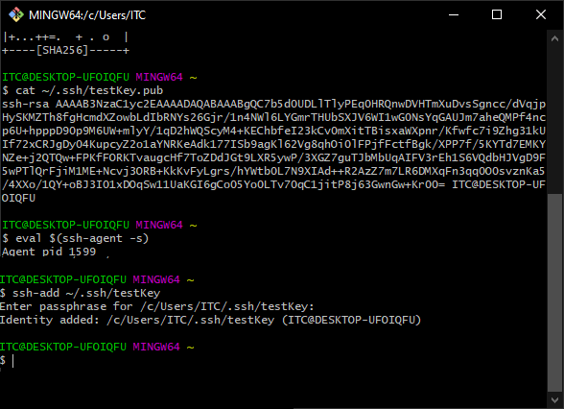
SSH Keys - Setting an SSH Key for GitHub
Add the SSH key to the agent
ssh-add ~/.ssh/testKey
Add the SSH key to the agent

Slide 20
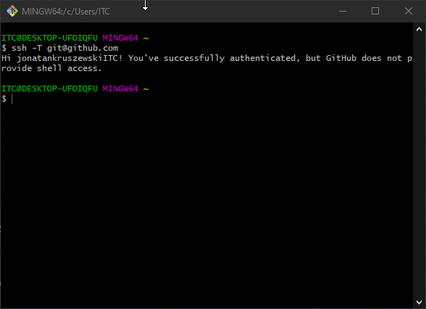
SSH Keys - Setting an SSH Key for GitHub
Check the connection:
ssh -T git@github.com
You should see a message as the one in the terminal.
At this point, you can delete the SSH keys files created on ~/.ssh or store them in a safer place.

Slide 21
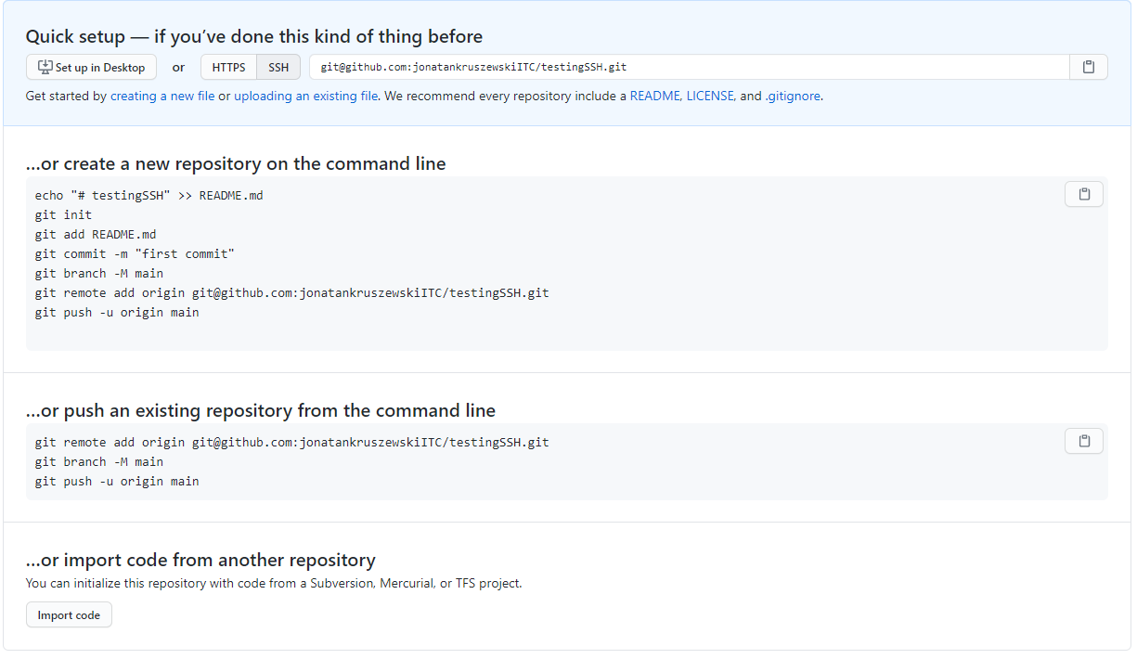
SSH Keys - Setting an SSH Key for GitHub
When creating / cloning a new repo use the SSH link

Slide 22
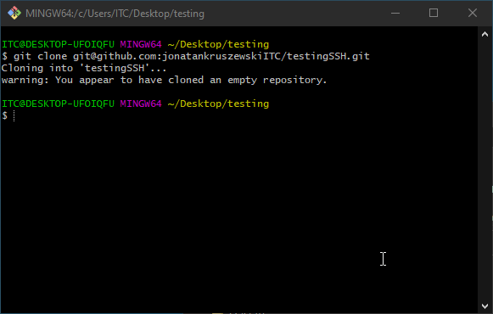
SSH Keys - Setting an SSH Key for GitHub
You can start using the new repo without using user/password.

Slide 23
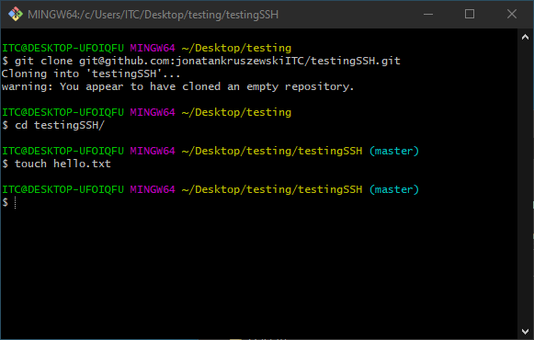
SSH Keys - Setting an SSH Key for GitHub
Lets create a file and commit it to test it

Slide 24
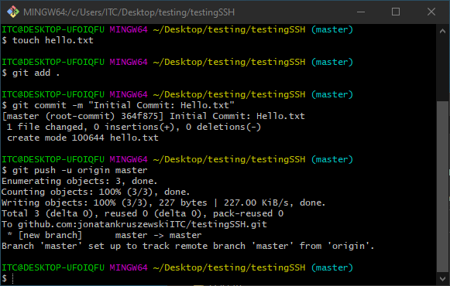
SSH Keys - Setting an SSH Key for GitHub
Push works successfully

Slide 25
Resources
T
SSH Documentation:
https://www.ssh.com/ssh/public-key-authentication
Digital Ocean Tutorial:
https://www.digitalocean.com/community/tutorials/ssh-essentials-working-with-ssh-servers-clients-and-keys#:~:text=SSH%20keys%20are%20a%20matching,can%20be%20used%20for%20authentication.&text=The%20public%20key%20can%20be,pair%20on%20their%20local%20computer.
Dev Tutorial:
https://dev.to/rmoff/ssh-keys-explained-2e2l
Beginners guide to SSH Keys
https://www.youtube.com/watch?v=hHs98hLtZJo&ab_channel=TechGuyDIY

Slide 26
Resources
T
Github Tutorial SSH Key generation:
https://docs.github.com/en/free-pro-team@latest/github/authenticating-to-github/generating-a-new-ssh-key-and-adding-it-to-the-ssh-agent

